Slide 1
Atliq Hardware's Analytics Project [SQL] WALEED ABDULLAH

Slide 2
Project analysis slide 2
Introduction
Problem statement
Chapters
Objectives
Tools used
Ad-Hoc Requests And
ERD
Business Value

Slide 3
Project analysis slide 4
Introduction
Atliq Hardwares is a leading computer hardware manufacturer based in India, with a well-established global customer base. The company aims to leverage data analytics to gain deeper insights into its product sales and customer behavior, ultimately supporting more informed, data-driven decision-making across its operations.
Tasks
Project Objectives
Schedules
Customer Objectives
Resources

Slide 4
Project analysis slide 5
Problem statement
Atliq Hardwares, despite being a leading computer hardware manufacturer with a global footprint, faces challenges in accessing actionable insights from their data. The management has observed a lack of timely, data-driven insights, making it difficult to make informed strategic decisions.
Key issues include:
Limited visibility into customer behavior, sales trends, and market performance.
Difficulty in identifying top-performing customers, regions, and product segments.
Lack of centralized, visual reporting tools to support executive-level decision-making.

Slide 5
Project analysis slide 5
Objectives
The primary objectives of the project are:
1. Problem Solving: To address 10 ad-hoc business requests by querying and analyzing the provided datasets.
2. Stakeholder Communication: To present findings in a professional and stakeholder-friendly format, ensuring clarity and relevance for top-level management.
3. Technical Proficiency: To demonstrate a deep understanding of SQL, including querying, aggregating, and manipulating data. Power BI tool is used for data visualization and present insights.
4. Strategic Thinking: To apply data analysis to solve real-world business challenges and propose data-informed recommendations for executive decision-making.

Slide 6
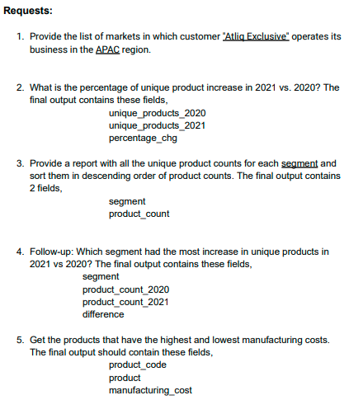
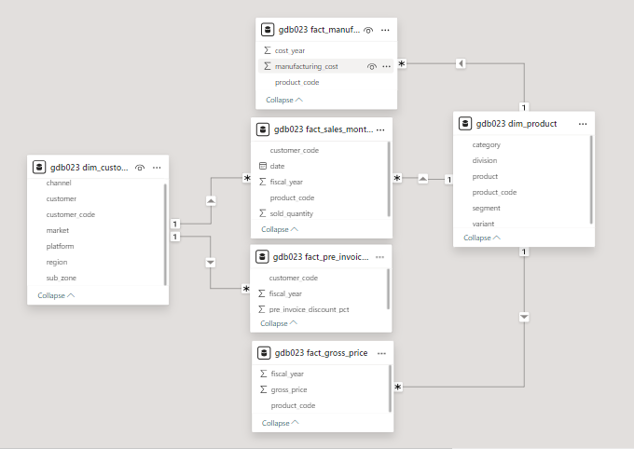
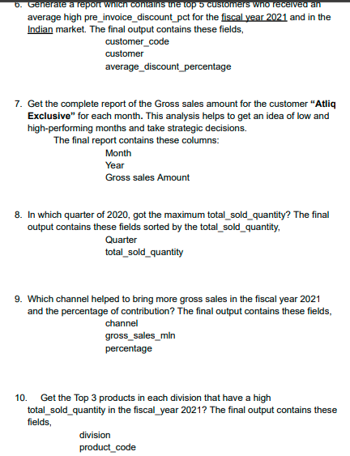
Project analysis slide 5
Ad-Hoc Requests And
ERD

Slide 7

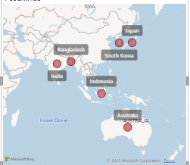
Project analysis slide 5
1. Provide the list of markets in which customer "Atliq Exclusive" operates its business in the APAC region.

Slide 8

Project analysis slide 5
2. What is the percentage of unique product increase in 2021 vs. 2020? The final output contains these fields, unique_products_2020 unique_products_2021 percentage_chg
36%
Insight:
The percentage increase from 2020 to 2021 is 36.3%. So we can say demand and production both are increased in 2021.

Slide 9
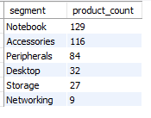
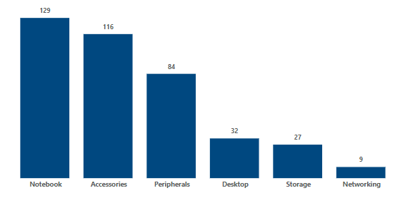
Project analysis slide 5
3. Provide a report with all the unique product counts for each segment and sort them in descending order of product counts. The final output contains 2 fields: segment, product_count

Slide 10
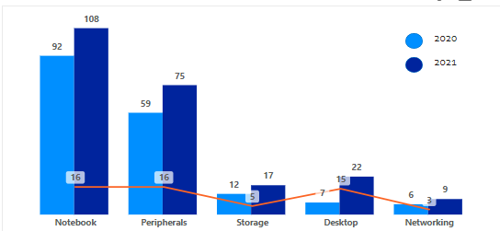
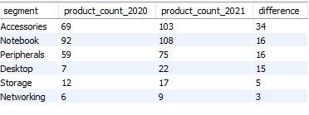
Project analysis slide 5
4. Follow-up: Which segment had the most increase in unique products in 2021 vs 2020? The final output contains these fields: Segment, product_count_2020, product_count_2021 difference
Insight:
• Accessories shows the most demands and production in 2021 as compare to other segment.
• Storage and networking shows the slowest growth.

Slide 11

Project analysis slide 5
5. Get the products that have the highest and lowest manufacturing costs. The final output should contain these fields: product_code, product, manufacturing_cost
Product with Max Manufacturing cost - AQ Home Allin1 Gen2
Product with Min Manufacturing cost - AQ Master Wired X1 MS

Slide 12
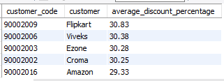
Project analysis slide 5
6. Generate a report which contains the top 5 customers who received an average high pre_invoice_discount_pct for the fiscal year 2021 and in the Indian market. The final output contains these fields: customer_code, customer, average_discount_percentage
Insight:
• The maximum pre_invoice_discount was given to flipkart.
• The minimum pre_invoice_discount was given to Amazon.

Slide 13
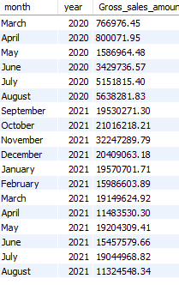
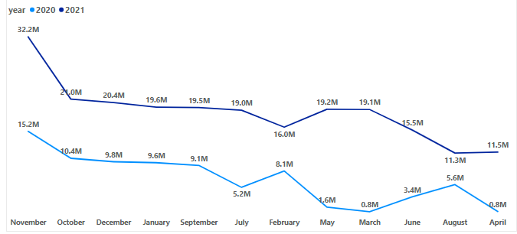
Project analysis slide 5
7. Get the complete report of the Gross sales amount for the customer “Atliq Exclusive” for each month . This analysis helps to get an idea of low and highperforming months and take strategic decisions. The final report contains these columns: Month, Year, Gross sales Amount
Insights:
• The lowest Gross Sales Amount is in FY 2020 march.
• The highest Gross Sales Amount is in November of both Fiscal year

Slide 14
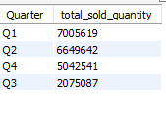
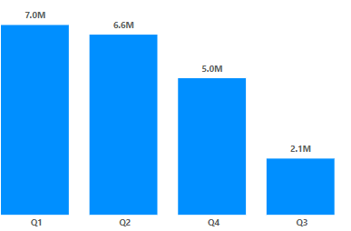
Project analysis slide 5
8. In which quarter of 2020, got the maximum total_sold_quantity? The final output contains these fields sorted by the total_sold_quantity: Quarter, total_sold_quantity
Insights:
• Q1 shows the maximum total_sold_quantity.
• Q3 shows the minimum total_sold_quantity.

Slide 15

Project analysis slide 5
9. Which channel helped to bring more gross sales in the fiscal year 2021 and the percentage of contribution? The final output contains these fields: channel, gross_sales_mln, percentage
Insights:
• Retailer helped to bring the maximum gross sales (73.22%).
• Distributer makes the least contribution in gross sales (11.31%).

Slide 16
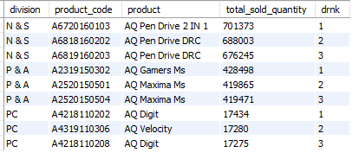
Project analysis slide 5
10. Get the Top 3 products in each division that have a high total_sold_quantity in the fiscal_year 2021? The final output contains these fields: division, product_code, product, total_sold_quantity, rank_order

Slide 17
Project analysis slide 5
Business Value
Enhanced Decision-Making:
Combines SQL-driven insights with Power BI visuals to provide a comprehensive view of the business for executives.
Customer and Market Insights:
Tracks patterns like customer discount behavior, sales performance, and market trends to support strategy development.
Scalable Analytics:
Serves as a model for integrating database querying with interactive reporting, paving the way for scalable data analytics solutions.

Slide 18
Thank You

